Slide 1
Key numbers:
Digital trends in Cambodia

Slide 2
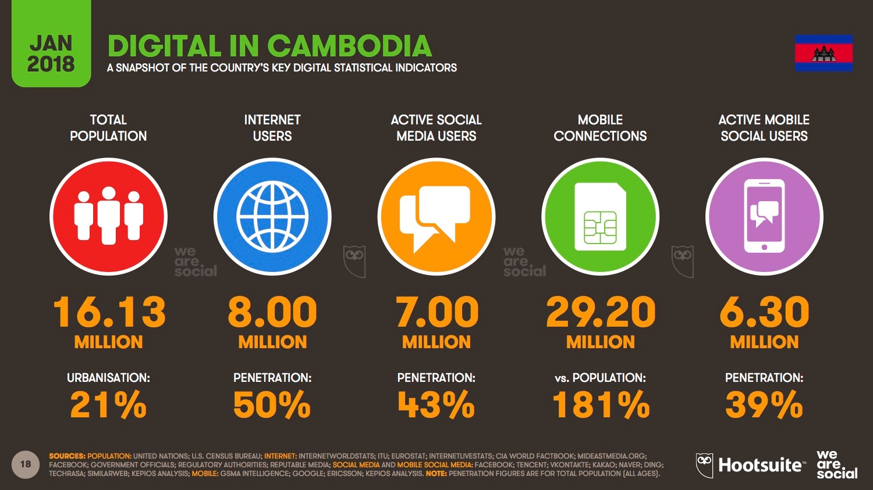

Slide 3
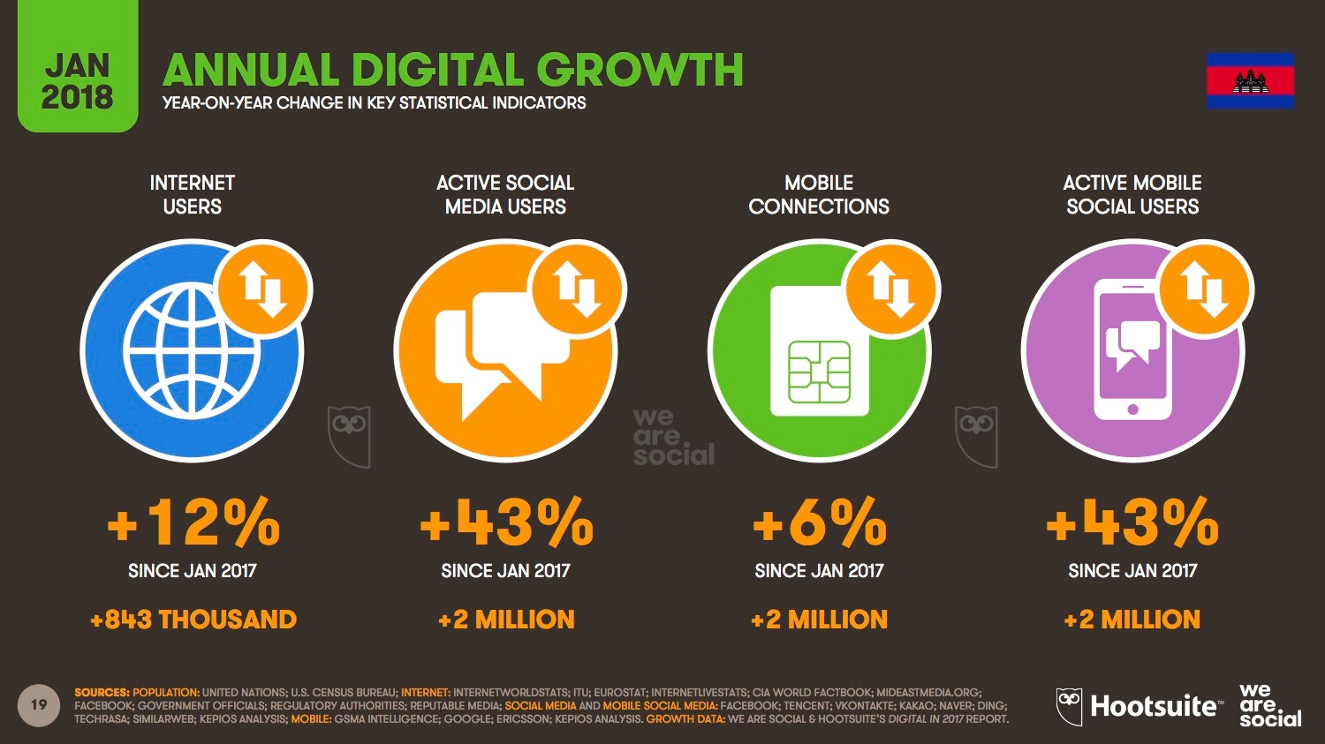

Slide 4
Digital Transformation for SMEs

Slide 5
What is digital transformation?
“Adapting or updating current business processes to incorporate digital strategies and technology into a company.”

Slide 6
Why digital transformation matters to SMEs?
The business world is changing rapidly, with new technologies being introduced to make processes more efficient, tailored and responsive.

Slide 7
Why digital transformation matters to SMEs?
SME leaders should view technology as means to boost their businesses, achieve greater efficiency and remain competitive:
By improving business agility thanks to digital resources (ex: cloud based storage and productivity tools).
By introducing new technologies to respond to new trends (ex: AI to automate time-consuming tasks).

Slide 8
How SMEs in Cambodia can be supported in their digital transformation?

Slide 9
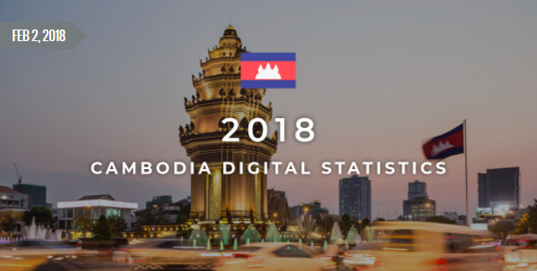
Geeks in Cambodia is the first online media in Cambodia that is 100% focused on startups and new technologies.

Slide 11
Ecosystem in Cambodia to support SMEs Digital transformation
Various stakeholders in the Kingdom are offering programmes and resources to support SMEs in their digital transformation, find out more with our panel of experts…

